Slide 1





Plaintiff and Defense Strategies on Non-Economic Damages
Victor Vital
Partner
Haynes Boone
Dallas
T +1 214.651.5329
Mark Trachtenberg
Partner
Haynes Boone
Houston
T +1 713.547.2528
Judge Harvey Brown
Of Counsel
The Lanier Law Firm
Houston
T +1 713.659520

Slide 2
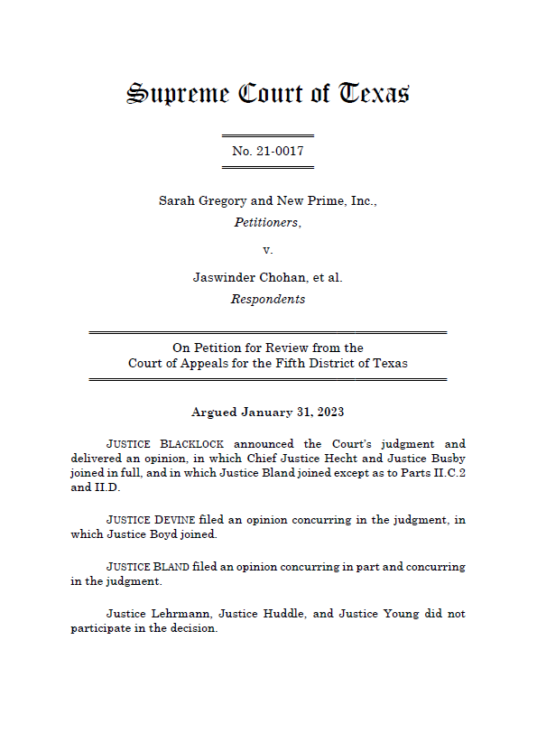

Alignment of Justices
in Gregory Opinions
Recusing:
Justices Huddle, Lehrmann, Young
Plurality
Opinion:
Justices Blacklock (author),
Busby, Hecht
Concurring
Opinion 1
Justices Devine (author), Boyd
Concurring
Opinion 2
Justice Bland
Notes:
Harvey – to start and cover overarching themes of 3 opinions.

Slide 3
Unified holding
Gregory v. Chohan, 670 S.W.3d 546 (Tex. 2023)
  $71M fighter jet
  $186M Rothko painting
  “Two cents worth” for every one of the 650M miles that its trucks drove during the year of the accident.
  Ct: No “unsubstantiated anchors.”
Notes:
Mark T. – to cover common ground of anti-anchoring.
Non-economic damages of $222M on survival and wrongful death claims.

Slide 4


Evidence that Cannot be Used to Prove
Non-economic Damages
“Unsubstantiated Anchoring”
“Flawed analogies” to amounts paid for unrelated objects
Mathematical calculations based on unrelated factors
Notes:
Mark – building on last slide.

Slide 5


A jury’s award of damages must be affirmed if:
Previous Standard of Review Expressly
Overruled by Gregory:
There is no extraneous evidence of bias or prejudice; and
The amount doesn’t shock the conscience of the court.
Notes:
Harvey

Slide 6
Principles from Parkway, Saenz, and Bentley Applied to Non-economic PI damages in Gregory:
Must be evidence to justify the amount awarded
Jury’s discretion is limited; it can’t simply pick a number
Notes:
Harvey

Slide 7
Principles from Parkway, Saenz, and Bentley Applied to Non-economic PI damages in Gregory:
Mental anguish only recoverable for “substantial disruption in daily routine” or “a high degree of mental pain and distress”
There must be proof of the “nature, duration, and severity” of mental anguish
Notes:
Harvey

Slide 8




The new battlefield on non-economic damages
Financial consequences of a life disrupted by mental anguish and loss of companionship
Comparison to damage awards in other cases
Evidence of the nature, duration, and severity of the injury
Notes:
Mark.

Slide 9
Case Comparison Approach
Anderson v. Durant, 550 S.W.3d 605, 620 & n.65 (Tex. 2018) - Noting, after comparing a trio of other similar cases, that the “jury’s $400,000 award appears to be excessive compared to awards in cases involving similar or more egregious behavior.”
Gregory v. Chohan, 670 S.W.3d 546 (Tex. 2023): “We do not foreclose the possibility that comparison to other cases may play some role in a plaintiff's effort to establish that a given amount of noneconomic damages is reasonable and just compensation rationally grounded in the evidence. We have in the past invoked similar reasoning.” (citing Anderson)
Exxon Mobil Corp. v. Brown, 2026 WL 59875 (TA 14th 2026) – “We may look to other cases as “reasonable guideposts” in our assessment of damages, though we must be mindful that each case is unique and that individuals may experience mental anguish in myriad ways.”) (citing Anderson).
Notes:
Mark

Slide 10

Themes of the
Devine-Boyd Dissent
Non-economic damages traditionally have been, and should be, left to the discretion of the jury.
Justices Devine (author), Boyd
Concurring
Opinion 1
Plurality erects an impossible barrier because noneconomic damages cannot be quantified.
Notes:
Harvey

Slide 11
Core Gregory Plurality Principles
Juries need rational, evidence‑grounded reasons for amounts.
Economic/non‑economic ratios are generally not probative without case‑specific reasons.
Unsubstantiated anchors are improper.
Precise quantification is not required but rational justification is.
DIVERITY & INCLUSION
Notes:
Harvey

Slide 12
Is Gregory’s “Rational Connection” Ruling binding?
Yes
  Team Indus. Services, Inc. v. Most, 711 S.W.3d 31 (TA1 2024, no pet.)
No
  Kelly Custom Homes, LLC v. Hopper, 2024 WL 3765393 (TA14 2024, pet. denied)
  Garza v. Escamilla, 712 S.W.3d 718 (TA14 2025, no pet.)
  Landry v. Currie, 2026 WL 249020 (Waco 2026, no pet. h.)
Notes:
Mark

Slide 13
A Plaintiff might argue:
“[P]recision is not required—and surely cannot be achieved when placing a dollar value on the emotional toll of losing a loved one.” Gregory, 670 S.W.3d at 551.
“[N]oneconomic harm transcends quantification entirely.” Id. at 557.
“We do not . . . suggest that in all cases there must be direct evidence of a quantifiable amount of damages. In other words, the requirement that some evidence support the amount of damages for emotional injury is not a requirement of precise quantification or a requirement that a particular type of evidence must always be proffered.” Id. at 560
Notes:
Harvey (do we want to unhide this one or leave in)?

Slide 14
P cannot explain “why” this damage award
Court stressed 4x
A Defendant might argue:
“Articulable reason why” – 1x
“rationally explaining why” – 2x
“case-specific reasons why” – 1x
Notes:
Mark (if we don’t unhide)
Gregory stressed the award must be “rational” –
Stated 24 times

Slide 15
Even if Gregory is not binding precedent, it should impact the way you should litigate non-economic damages!
Notes:
Harvey – takes it from here…. Until D slides.

Slide 16
Practical Tips for plaintiffs for Proving Non-economic Damages Post-Gregory

Slide 17
Avoiding Unsubstantiated Anchors
Avoid misplaced monetary guidelines for damages both in the evidence by analogy and in closing argument.

Slide 18
Avoiding Unsubstantiated Anchors
“suggest[ing] an amount of damages with reference to objects or values having no rational connection to the facts of the case.” Garza v. Escamilla, 712 S.W.3d 718 (14th)

Slide 19
Avoiding Unsubstantiated Anchors
Per diem of $16/day or $1/hour for every waking hour ok. Garza
Six COAs for almost 70 years have held permissible

Slide 20
Avoiding Unsubstantiated Anchors
Use life expectancy charts

Slide 21
Avoiding Unsubstantiated Anchors
Garza: Jury argument referring to the billions spent on medications to avoid pain was not preserved

Slide 22
Avoiding Unsubstantiated Anchors
Garza: Jury argument that pain is both expensive and intolerable has rational connection to evidence, particularly in view of per diem argument

Slide 23
Avoiding Unsubstantiated Anchors
Potential problems if argue for large amounts per day or hour?

Slide 24
Consider using medical expenses for pain avoidance
Potential problems if argue for large amounts per day or hour?
Notes:
Rob Ammons: For example, assume you have a client who is experiencing neck pain following a rear-end collision. A treating physician is likely to testify that Cervical epidural steroid injection (ESI) will offer modest but temporary pain relief. For example, a 2020 review of studies found that about 50% of people get at least 50% pain relief, typically lasting several days to a few months or longer.
The ESI procedure costs will be contained in the medical bills, which will likely be offered into evidence. Medical billing for the ESI will likely include multiple components: the physician's professional fee, the facility fee for the hospital or ambulatory surgery center, the cost of fluoroscopic guidance, and the anesthesia services. Assume that the total costs are between $2,000 and $4,000. This averages out to $3,000 for a month on average of 50% pain relief.
If people are willing to pay $3,000 a month for 50% pain relief, it’s logical that if they had the resources, they would pay $6,000 for a month of total pain relief. In the case of a client with permanent neck pain, a rational argument can be made for $72,000 a year in pain and suffering damages for the remainder of the client’s life expectancy.

Slide 25
Draft the Charge in View of Gregory
Consider Defining Physical impairment: see Negligence PJC 28.3, Comment (2024)

Slide 26
Provide Parkway factors?
Factors to consider in awarding compensatory damages, if any, are the nature, frequency, duration and severity of any physical pain or mental anguish sustained by Plaintiff that resulted from the occurrence in question.
Parkway v. Woodruff, 901 S.W.2d 434, 444 (Tex. 1995); Gregory, 670 S.W.3d at 557.

Slide 27
Drafting the Charge
“Compensation can only be for mental anguish that causes ‘substantial disruption in ... daily routine’ or ‘a high degree of mental pain and distress.’” Gregory, 670 S.W. 3d at 555 (quoting Parkway, 901 S.W.2d 434, 444 (Tex 1995).

Slide 28
Expressly discuss nature, duration, [frequency],and severity

Slide 29
Team Industrial Services v. Most
No bifurcated trial on punitives and then nonsuited
Refused requested instruction n.13
  Your award, if any, for compensatory damages should not consider damages as a penalty or by way of punishment.

Slide 30
Effectively Use Lay Witnesses to Establish Non-economic Damages

Slide 31
Day in Life Films

Slide 32

Use photographs and demonstrative exhibits
Put in record

Slide 33
Explain and explain
Tell the jury why explaining

Slide 34
One possible suggestion
“P should offer evidence of how a particular monetary amount would be a step toward making the plaintiff whole. That is, the P should endeavor to explain how cash might off-set some of the distress.” Keltner and deKeratry, Advocate Fall 2024
Ex: How often did you play tennis? What would you pay to play tennis again each week?

Slide 35
P cannot be cross-examined on the amount of non-economic damages
Q: State the amount of money you are claiming for physical pain and
mental anguish in the future, and state all factors relied upon by you
in arriving at such amount.
A: I will ask the jury to decide this.
Baylor Med. Plaza Services Corp. v. Kidd, 834 S.W.2d 69, 78 (Texarkana 1992, writ denied) (matter for pleadings)

Slide 36
What about direct examination on the amount of damages?
Property damage rule
Sentimental value of property
Notes:
Tim Riley

Slide 37
Possible direct examination
Q: if the defense were to argue that fair and reasonable compensation
to you for the loss of your husband would be the amount you could be
paid for a minimum wage job, $7.25 per waking hour, would you agree
or disagree that $7.25 per hour was a fair and reasonable amount to
compensate you for the loss of your husband?
A. It would not be a fair amount.
Q. In your opinion would $30 per waking hour would be fair and
reasonable compensation for your suffering?
A. No. [Note $30/hour would be 480/day for 16 hours)
Notes:
Tim Riley

Slide 38
Possible Direct examination
Q: What would it be worth to you to go all day without the anxiety,
sleeplessness, worry and from mental anguish you suffer daily?
Q: If you could pay to get through a day without the crushing weight of knowing you'll never be the father you planned to be, what would that be worth to you?
Notes:
Rob Ammons

Slide 39
Breakdown in components
Consider sleep disruption at a specific dollar amount per night of lost restorative sleep,
anxiety episodes valued per episode times their frequency,
depressive days calculated per day times occurrence rate,
relationship strain valued daily for damaged marital intimacy, and
parental grief assessed per day for inability to parent as desired.
Notes:
Rob Ammons

Slide 40
Final argument
The law requires me to explain why our requested award is a fair amount.. . Here’s why: Steven experiences anxiety that disrupts his sleep every single night—that's 12,775 nights over 35 years. He testified he'd pay $25 per night for peaceful sleep. That's $319,375. He battles depression requiring medication to lessen the emotional pain every day—365 days times 35 years times $30 per day equals $383,250. He grieves his lost identity as a capable provider—$40 daily for 35 years equals $511,000. Total: $1,213,625. We're asking for $1 million. That's not speculation, it's math based on the evidence about his daily suffering."
Notes:
Rob Ammons

Slide 41

Effectively Use Lay Witnesses to Establish Non-economic Damages

Slide 42

Types of Lay Witnesses
Co-workers and managers
Clergy
Friends
Educators
Business partners

Slide 43

Minimum Life Care Plan: $29,916,807
Loss of Earnings: $2,897,367
Household Services: $568,596
Past Medical Bills: $1,500,000+
$34,882,770
TOTAL ECONOMIC DAMAGES
Economic
Non-Economic
Freedom
Independence
Dignity
Happiness
Safety
Spouse you once knew
Best friend
Partner
Parent
Companionship
Emotional Support
Conversation
Stability
Peace of mind
Mobility
Ability to assist
Activities
Travel
Fun
Role Model
Guidance
Comfort
Breadwinner
Family leader
Dignity
Can’t eat what he wants
Can’t eat when he wants

Slide 44
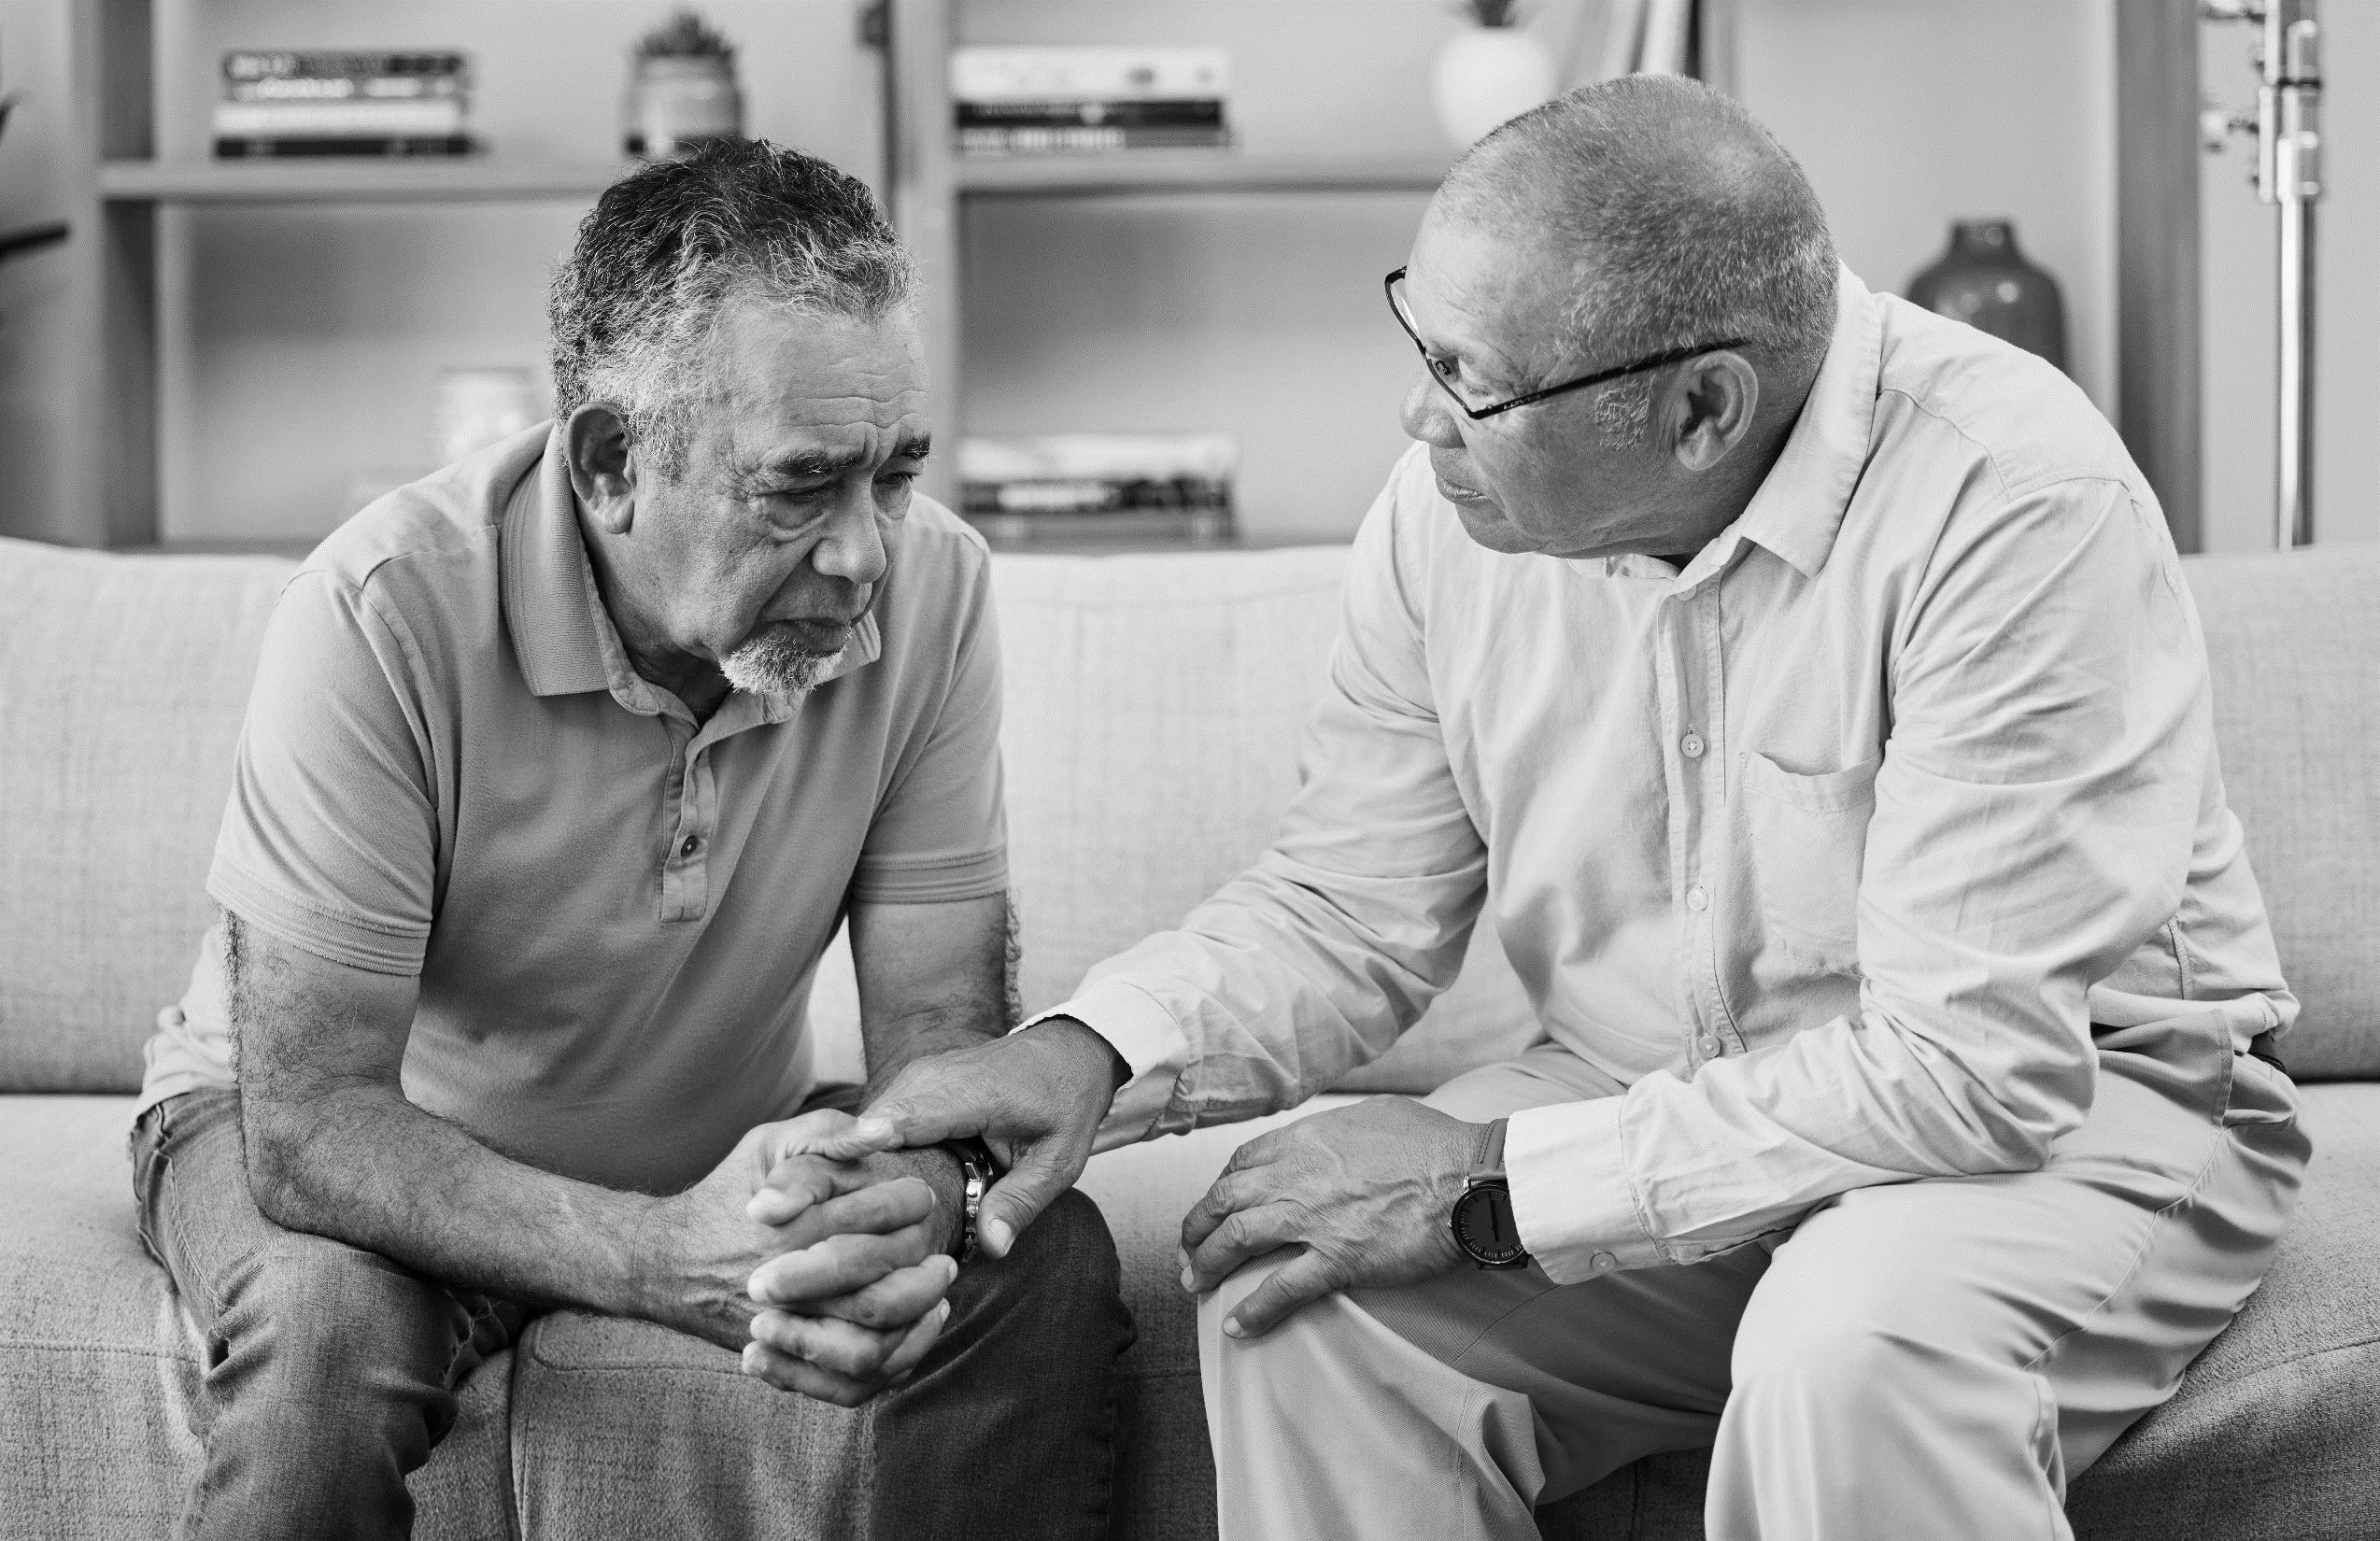
Use Expert Testimony to Establish Non-economic Damages

Slide 45

The Rational Alternative
A Unified Defense Trial and Appellate Strategy on Non‑Economic Damages Post‑Gregory
Notes:
Victor Vital

Slide 46
The Strategy? A Unified Approach.
Shape an evidentiary record and charge‑tracked argument that makes large awards appear irrational at trial.
Contextualize any verdict on appeal using comparative tools to show whether it is an outlier lacking evidentiary support.
Notes:
Mark T

Slide 47
Counter-Anchoring: What, When and Why?
Counter-anchoring reduces the gravitational pull of plaintiff’s number and should be used judiciously based on liability strength, case emotion, and available relationship‑specific proof.
Counter‑anchoring = offering a conditional, evidence‑based alternative that supplies jurors a rational framework.
DIVERSITY & INCUSION
Notes:
Victor V.

Slide 48
Counter-Anchoring Guardrails
Counter‑anchors should not be “frivolous” or unmoored.
Counter-anchors must be tightly tied to record evidence and framed as conditional so as not to concede liability.
Notes:
Victor V.

Slide 49

Operationalize the PJC’s Non-Economic Damage Considerations
Notes:
Victor V.

Slide 50
Operationalize the PJC’s Non-Economic Damage Considerations in Discovery
“Living Arrangements”: Was the plaintiff actually living with the decedent? Or had they moved out years ago? E.g., establish separations and periods of non‑cohabitation; quantify days, weeks, and months apart; and corroborate with leasing records, utility accounts, mail, school records, travel logs, and location data.
“Extended Absences”: Were there long periods of no contact? E.g., identify work travel, deployments, relocations, hospitalizations, incarceration, or estrangements; lock down dates and durations; obtain contemporaneous communications that reflect the frequency and quality of contact during absences.
“Harmony of Family Relations”: Don't settle for “we loved him.” E.g., dig for estrangement, conflicts, dysfunction, separations, family violence, protective orders, and substance abuse and associated dysfunction; neutral witnesses—neighbors, clergy, teachers, supervisors—carry outsized credibility on harmony or discord.
“Common Interests and Activities”: Was this a relationship of daily interaction or merely holiday visits? E.g., move beyond generalities: what activities, how often, how long, and how recently? Who else participated? Are there photos, calendars, membership records, or transaction histories that reflect participation?
DIVERSITY & ICLUSION
Notes:
Victor V.

Slide 51
Operationalize the PJC’s Non-Economic Damage Considerations in Closing Argument
Principled discussion of the PJC’s non-economic damage considerations to lower the courtroom temperature—cloak yourself in the Court’s charge, i.e., “The Court has instructed you…”
Arming defense-oriented jurors with the law/judge’s instructions allows them to argue in deliberations on a non-emotional basis based upon the defense’s development of the PJC’s considerations.
DIVERSITY & ICLUSION
Notes:
Victor V.

Slide 52
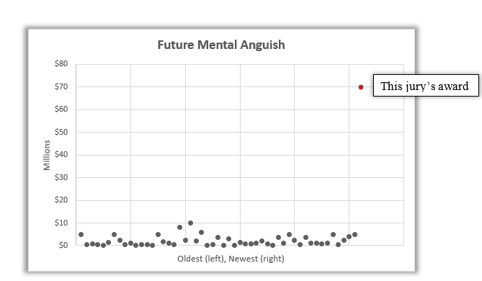
The Appellate Hammer
Notes:
Mark - Explain scattergrams as a visual/statistical way to situate the verdict among comparable wrongful‑death awards in the jurisdiction, enabling courts to see outliers and demanding record‑based reasons for any extraordinary deviation; reference briefs deploying this method

Slide 53
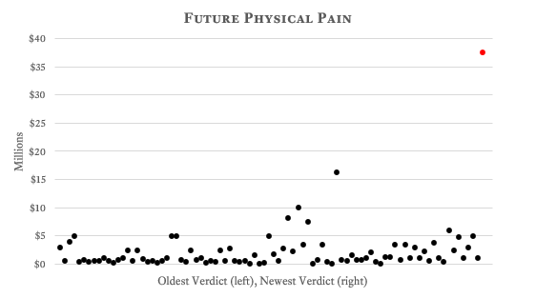
Applying Context: “Ordinary vs. Extraordinary” on Appeal
Notes:
Mark

Slide 54
ExxonMobil v. Brown, 2026 WL 59875 (14th COA 2026)
Category | Brown | Roque | Friels
Future Medical | $416K | $374K
Earnings (Past) | $104K | $45K
Earnings (Future) | $90K | $874K
Past Pain | $2M | $1.5M | $150K
Future Pain | $2M | $3M
Past Anguish | $2M | $1.5M | $200K
Future Anguish | $2M | $1.5M | $1.5M
Past Impairment | $1.5M | $2M | $150K
Future Impairment | $2M | $1M
Past Disfigurement | $500K | $250K
Future Disfigurement | $500K | $250K
Key: Yellow highlighting – challenged on appeal. Red – stricken on factual insufficiency grounds. Blue – stricken on legal insufficiency grounds.
Notes:
Mark

Slide 55
ExxonMobil v. Brown (14th COA 2026)
Entire award reversed, even awards unchallenged on appeal. Scope of new trial = liability plus damages, minus categories in which awards were supported by legally insufficient evidence.
No remittitur because no guidance offered on how to calculate.
Ringing endorsement of the case comparison approach. “[W]e may look to other cases as “reasonable guideposts” in our assessment of damages.” Op. at 20.
Notes:
Mark

Slide 56
Key Takeaways
Never cede damages—force Plaintiff to prove every element.
Run discovery to the PJC to shape the charge and limit theories..
Decide whether to counter‑anchor early and strategically.
Object and preserve at every damages inflection point.
Build an appellate record distinguishing ordinary from extraordinary awards.
Use comparative analytics on appeal to show when a verdict is an outlier.
Notes:
Victor V.

Slide 57

We welcome your questions and discussion.

